Slide 1
Digital Design II
Abdulrahman Ibrahim
Areeg Mostafa
Mariam Amr
Hossam Elsamanoudy
Dr. Mohammed Shalan

Slide 2

SPEF Extractor

Slide 3
What is spef ?
Stands for Standard Parasitic Extraction Format
IEEE standard for representing data of wires of a chip in ASCII format
Useful for :
Delay calculation
Speed of operation ( meeting timing requirements)
signal integrity (quality of the signal)

Slide 4

Project Target
Input Data :
LEF file (Library Exchange Format)
DEF file (Design Exchange Format)
LIB file (Liberty Timing File)
Output Data :
SPEF file

Slide 5
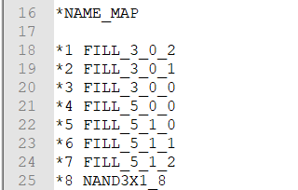
Components of SPEF
Name Mapping
allows long names to be mapped to shorter numbers preceded by an asterisk (sort of abbreviation)
Used to reduce the file size

Slide 6
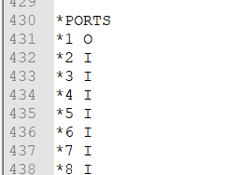
Components of SPEF
2. Port Section
The port section is simply a list of the top level ports in a design
They are also annotated as input, output or bidirect with an I, O or B.

Slide 7
Components of SPEF
3. *CONN sections
The *CONN section lists the pins connected to the net
*I <pin name> <direction> *C <loading or driving information>
The pin name is the name of the pin
The direction will be I, O, or B, corresponding to input, output, or bidirectional signals, respectively.
The xy coordinate will be the location of the pin in the layout.
For an input, the loading information will be *L and the pin's capacitance.
For an output, the driving information will be *D and the driving cell's type.

Slide 8
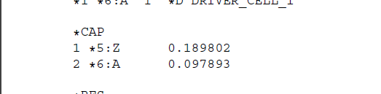
Components of SPEF
4. *CAP sections
The *CAP section provides detailed capacitance information for the net
A capacitor lumped to ground has three fields:
an identifying integer,
a node name, and
the capacitance value of this node.

Slide 9
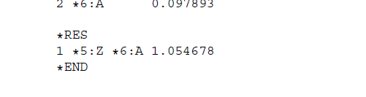
Components of SPEF
5. *RES sections
The *RES section provides the resistance network for the net.
Entries in the *RES section contain 4 fields:
an identifying integer,
two node names, and
the resistance between these two nodes

Slide 10
Deliverables 1
Parsed the def and lib file for:
Name Mapping
Ports
CONN section without capacitance and resistance calculations
Simply the skeleton of the SPEF file

Slide 11
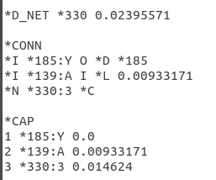
Deliverables 2
Parsed the LEF/LIB and DEF routed file for:
Get the wire length per metal from DEF
WIDTH, RPERSQ, CPERSQDIST, EDGECAPACITANCE per metal layer from LEF
Fully Calculating and finishing the Capacitance section

Slide 12
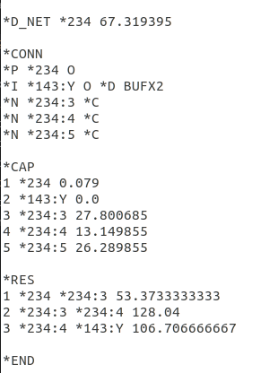
Deliverables 3
Parsed the LEF/LIB and DEF routed file for:
Get the wire length per metal from DEF
WIDTH, RPERSQ, CPERSQDIST, EDGECAPACITANCE per metal layer from LEF
Fully Calculating and finishing the Capacitance section
Fully Calculating and finishing the Resistance section

Slide 13
References
Bhasker, J., and Rakesh Chadha. Static Timing Analysis for Nanometer Designs: a Practical Approach. Springer, 2011
Dietrich, Manfred, and Joachim Haase. Process Variations and Probabilistic Integrated Circuit Design. Springer New York, 2012.
LEF/DEF Language Reference - www.ispd.cc/contests/14/web/doc/lefdefref.pdf.

